Slide 1


“Social Buzz”
Data Analysis
By:
Harshit Gahlaut

Slide 2


Today's agenda
Project recap
Problem
The Analytics team
Process
Insights
Summary

Slide 3


“Social Buzz” is a fast growing technology
unicorn that need to adapt quickly to it's
global scale. Accenture has begun a 3 month POC focusing on these tasks:
•An audit of Social Buzz's big data practice
•Recommendations for a successful IPO
•Analysis to find Social Buzz's top 5 most popular categories of content
Project Recap

Slide 4


Problem
The client has reached a massive scale within recent years and does not have the resources internally to handle it.
Social Buzz receives over 100000 posts per day which amounts 36,500,000 posts every year, of which this all unstructured data making it very hard to make a sense.
Identify the requirements that need to be delivered for this project.
Merging of sample data set tables
An analysis of their content categories that highlights the top 5 categories with the largest aggregate popularity

Slide 5


Andrew Fleming
Chief Technology Architect
The Analytics team
Marcus Rompton
Senior Principal
HG
Harshit Gahlaut
Data Analyst

Slide 6

Process
1
Data Understanding
2
Data Cleaning
3
Data Modelling
4
Data Analysis
5
Uncover Insights

Slide 7


Insights
UNIQUE
CATEGORIES
REACTIONS TO "ANIMAL" POSTS
MONTH WITH
MOST POSTS
16
1897
May

Slide 8
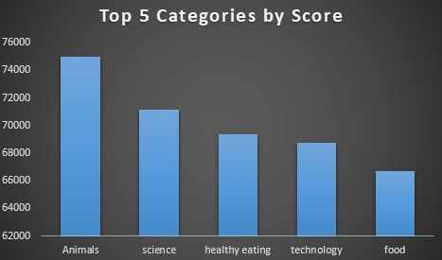

Slide 9
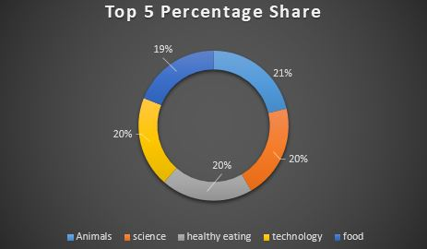

Slide 10
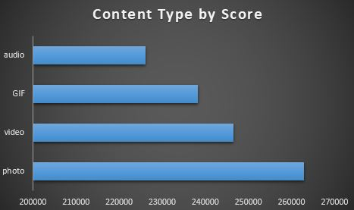

Slide 11


Animals and science are two of the most popular content categories, this shows that people enjoy “real-life” and “factual” content the most. So I would recommend that you keep creating more contents relating to these two categories.
Food is a common theme with the top 5 categories with “Healthy Eating” ranking as one of the highest. This may give an indication to the audience within your user base. You could use this insight to create a campaign and work with healthy eating brands to boost user engagement.
Summary
With rise in technology it is no surprise to see contents related to technology right up with the top categories. It show users enjoy your technology contents. I would recommend collaborating with some of the world’s tech giants as this would definitely make user engagement skyrocket.

Slide 12

Thank you!
ANY QUESTIONS?

